Slide 1
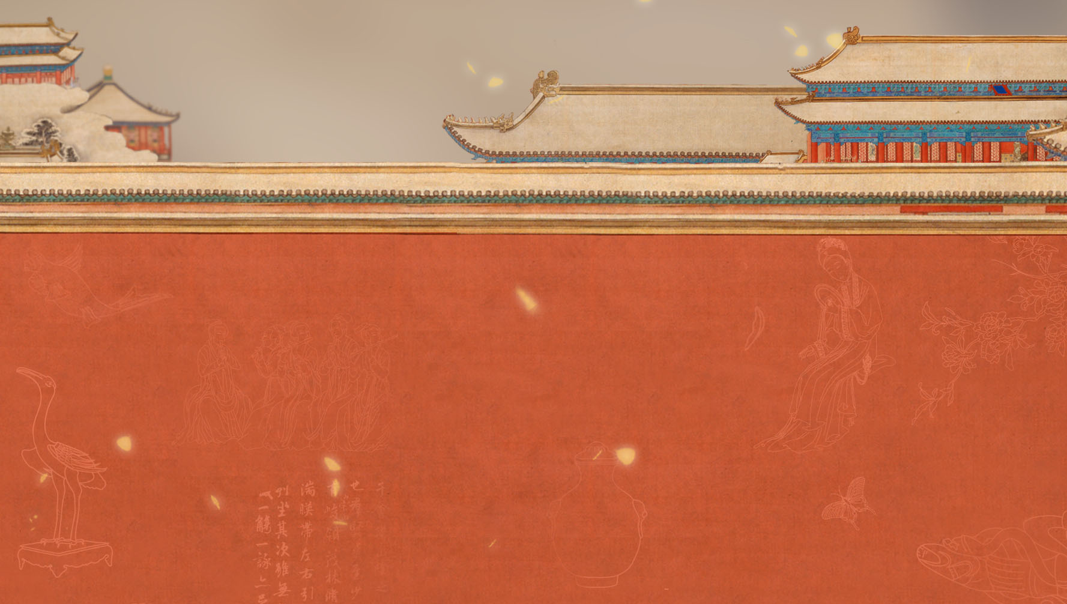
汉语桥
故宫笔记
陈
晨
CHINESE BRIDGE
线上项目招生简章
online program enrollment guide

Slide 2
课程设置
美丽外大
师资队伍
申请流程
CURRICULUM
BEAUTIFUL TFSU
FACULTY
APPLICATION PROCESS

Slide 3
课程设置
美丽外大
师资队伍
申请流程
CURRICULUM
BEAUTIFUL TFSU
FACULTY
APPLICATION PROCESS

Slide 4
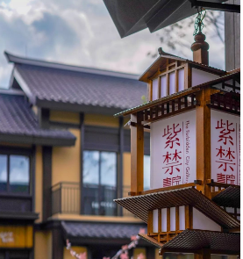
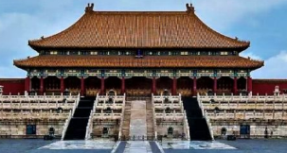
1
紫禁书苑
2
Forbidden bookstores
云游紫禁城
3
Traveling around the Forbidden City
云端互动
Online Interaction

Slide 5
语言水平——初级、中级、高级
语言技能——听、说、读、写
课程内容——词汇、语法点
故宫文化——知识点
Language level——elementary, intermediate, advanced
Language skills-listening, speaking, reading and writing
紫
禁
书
苑
Course content-vocabulary, grammar points
Forbidden bookstores
Cultural knowledge points of the Forbidden City

Slide 6
概述
皇帝
宫殿
建筑
Introduction
Emperor
Palace
Architecture
云
游
紫
禁
城
神兽
书画
珍宝
节日
Traveling in the Forbidden City
Celestial monsters
Painting
Treasure
Festival

Slide 7
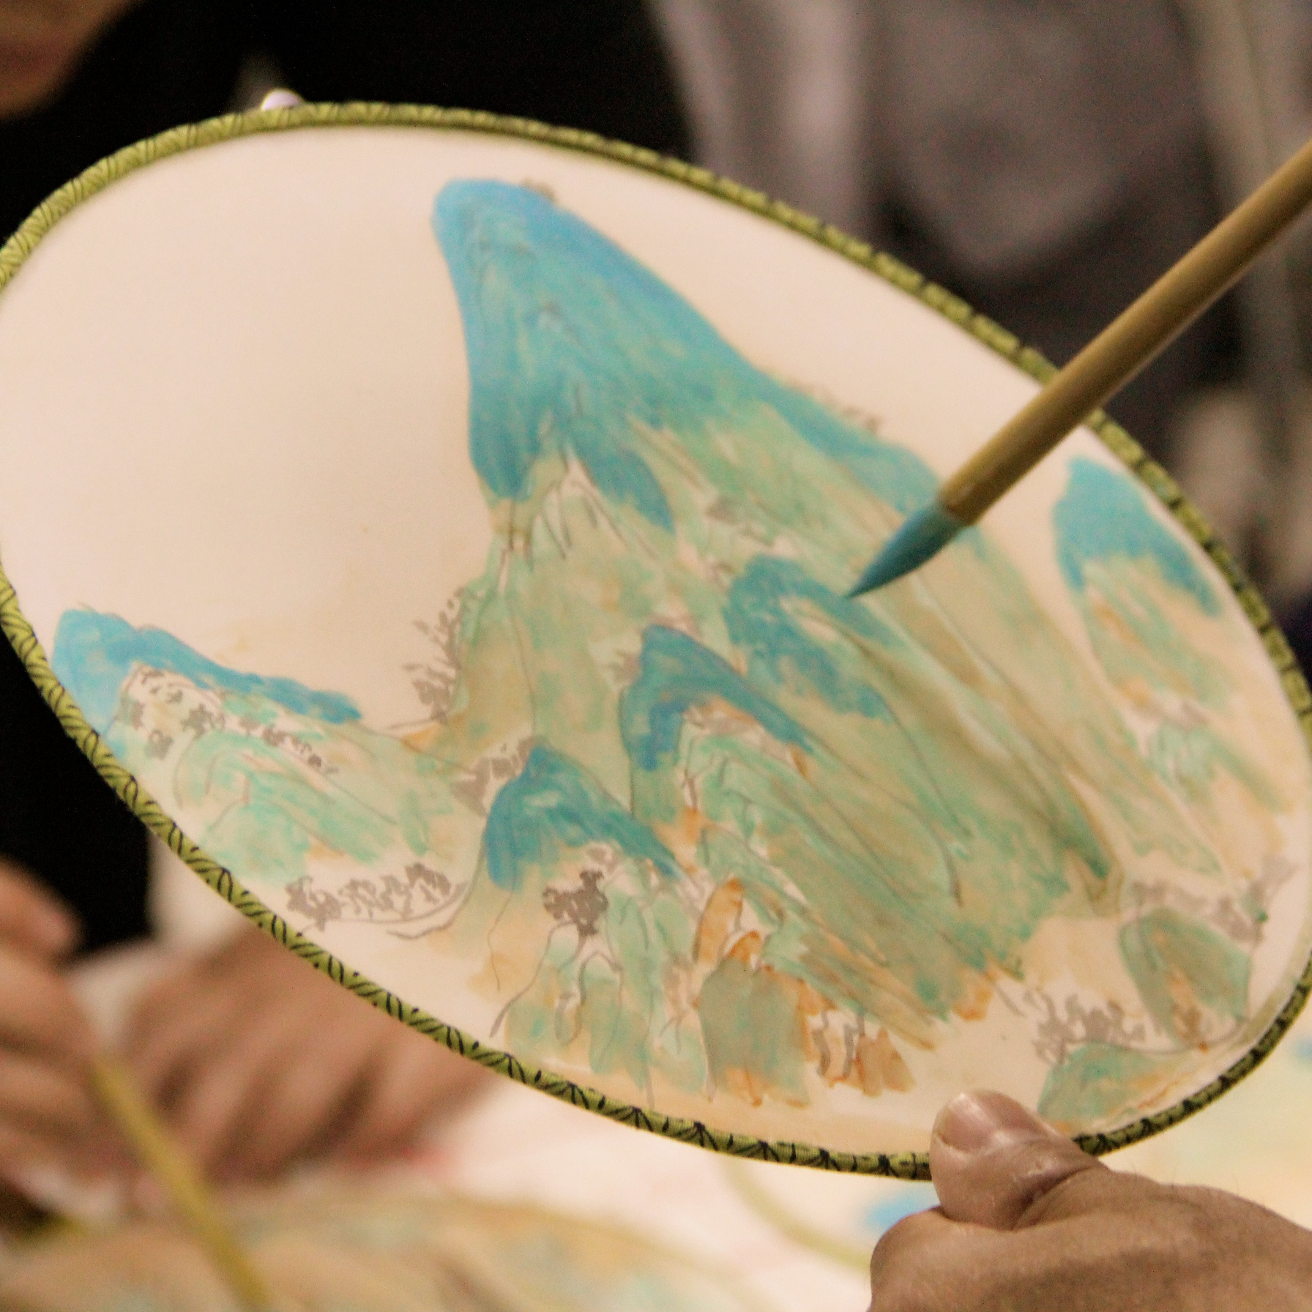
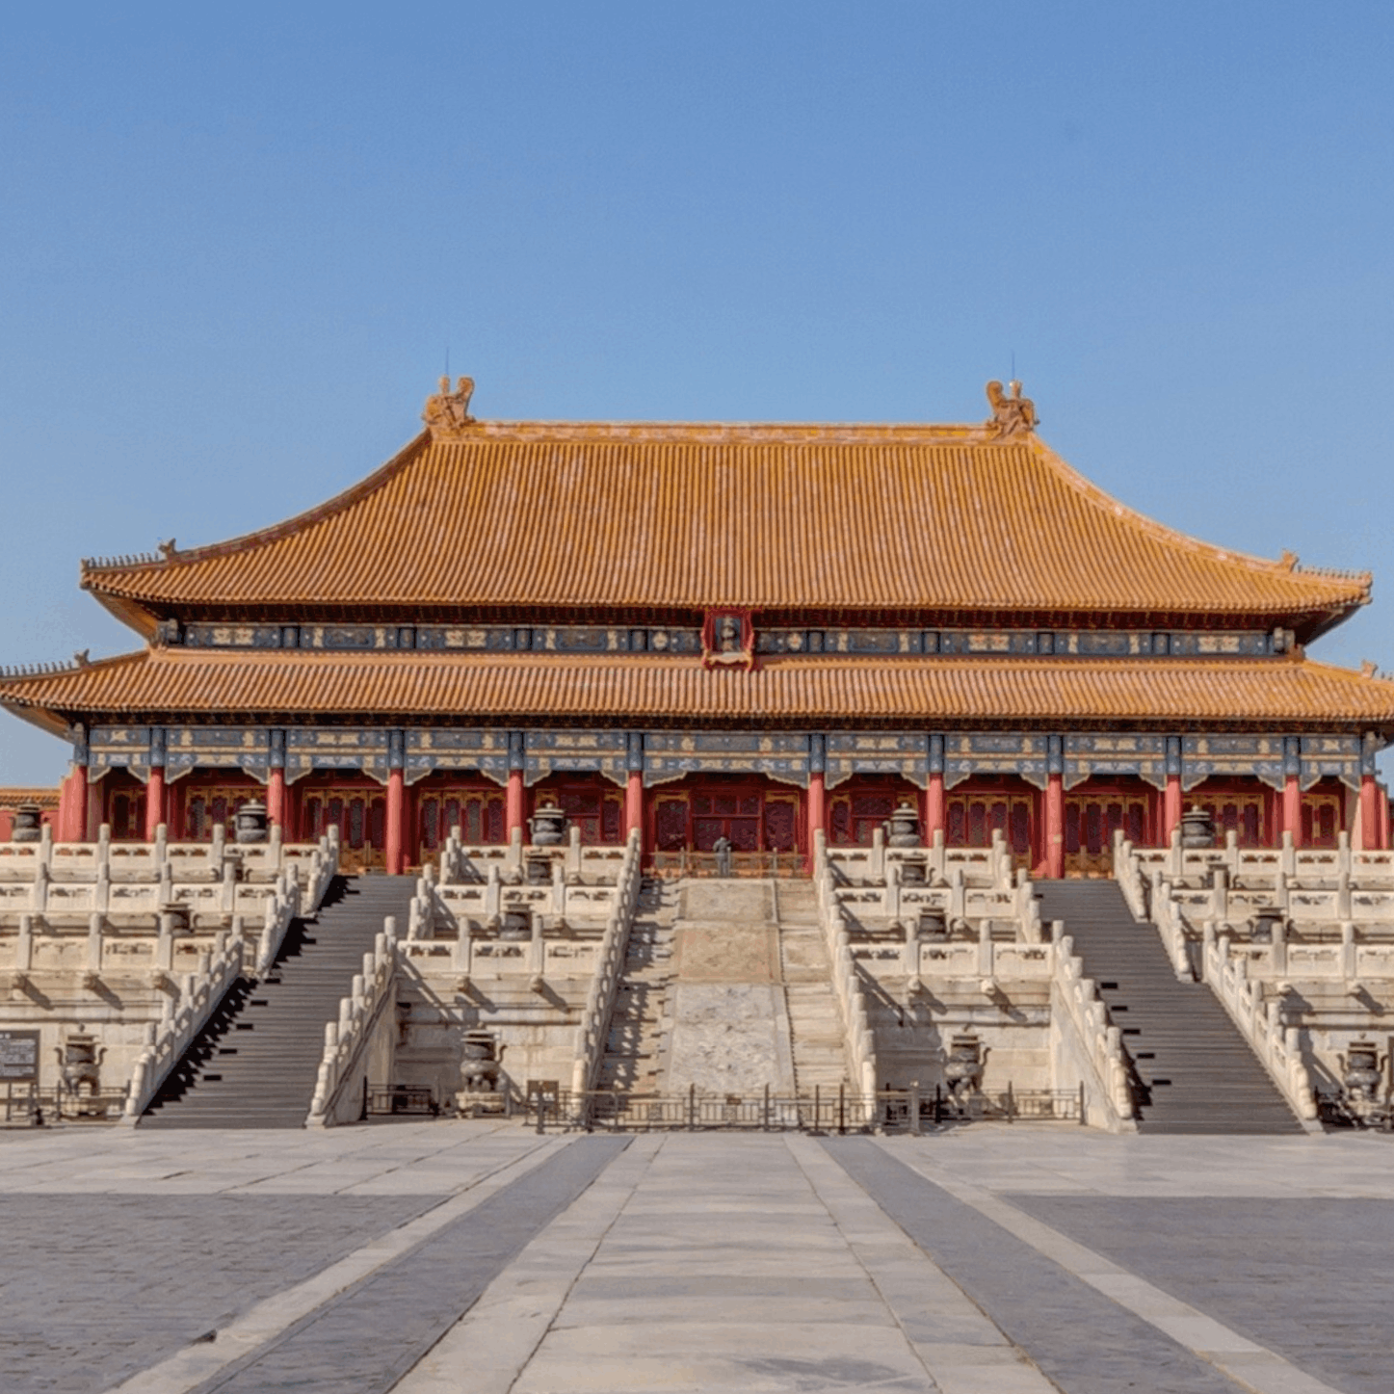
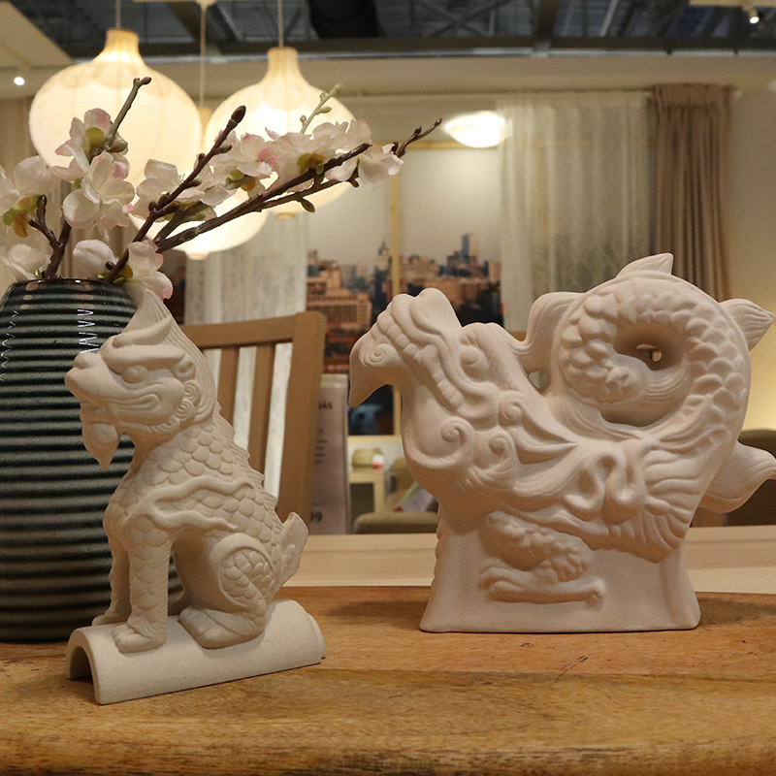
“千里江山图”绘制
“金瓯永固杯”制作
云
端
互
动
Online interaction
宫殿搭建
故宫神兽
宫灯制作

Slide 8
课程设置
美丽外大
师资队伍
申请流程
CURRICULUM
BEAUTIFUL TFSU
FACULTY
APPLICATION PROCESS

Slide 9
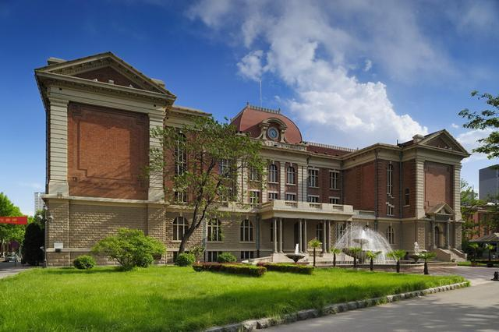
美丽外大
天津外国语大学建于1921年，是天津市一所外语语种齐全，文学、经济学、管理学、法学、教育学、艺术学、工学等多学科协调发展的天津市属重点院校。
BEAUTIFUL TFSU
Established in 1921, Tianjin Foreign Studies University is a key university in Tianjin, with
a complete range of foreign languages, literature, economics, management, law, education, art, engineering and other coordinated developments of multifaceted disciplines.

Slide 10
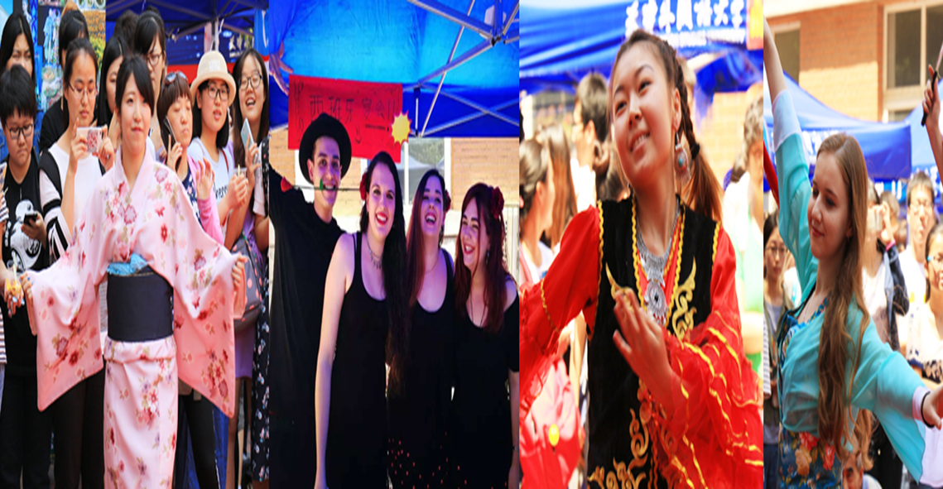
学校坚持走国际化办学之路，积极服务“一带一路”倡议，与世界30多个国家的220余所大学和教育机构建立了友好合作关系。学校接收“中国政府奖学金”、“孔子学院奖学金”、“天津市政府奖学金”外国留学生，设有“天津外国语大学来华留学生新生奖学金”，每年接收来自世界60多个国家的近2000名长短期留学生来校攻读本科、硕士、博士学位或者短期研修。
TSFU adheres to the road of internationalization, actively serves the "Belt and Road" initiative, and has established friendly cooperative relations with more than 220 universities and educational institutions in more than 30 countries around the world. The school accepts students with "Chinese Government Scholarship", "Confucius Institute Scholarship", "Tianjin Municipal Government Scholarship“ and "Tianjin Foreign Studies University Freshman Scholarship“. Every year, TSFU accepts nearly 2,000 long-term and short-term international students from more than 60 countries around the world to come study for undergraduate, masters, doctorate or short-term study programs.

Slide 11
课程设置
美丽外大
师资队伍
申请流程
CURRICULUM
BEAUTIFUL TFSU
FACULTY
APPLICATION PROCESS

Slide 12
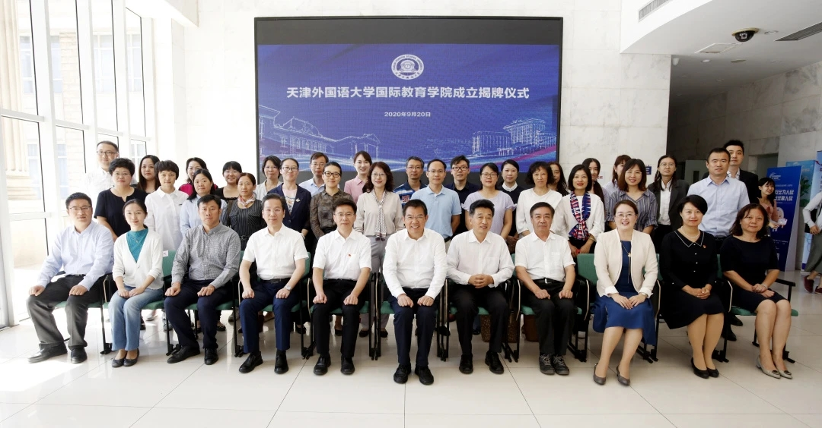
师资队伍
天津外国语大学国际教育学院有着优秀的教师团队，现有专职教师27人，其中正、副教授17人，讲师10人。其中博士后1人，博士15人。
Faculty
The College of International Education, of TFSU, has an extraordinary team of teachers. The faculty boasts 27 full-time teachers, including 17 professors and associate professors and 10 lecturers. Among them, there is 1 postdoctoral fellow and 15 doctoral fellows.

Slide 13
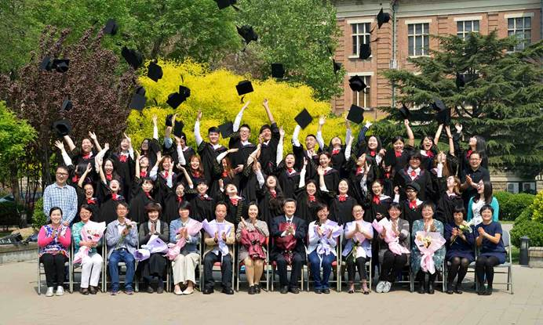
我院80%教师都具有在国外担任汉语教师讲学、国外研修的海外经历。在国内，教师们承担着留学生本科生、研究生、进修生等本科课程、研究生课程、2+2项目课程、通识语言课程、短期班课程以及组织各种各样的文化活动。
80% of the teachers at Tianjin Foreign Studies University have overseas experience as a Chinese language teacher abroad, and/or received overseas training. In China, teachers undertake undergraduate courses, postgraduate courses, 2+2 project courses, general language courses, short-term courses and organize various cultural activities for international students.

Slide 14
课程设置
美丽外大
师资队伍
申请流程
CURRICULUM
BEAUTIFUL TFSU
FACULTY
APPLICATION PROCESS

Slide 15
申请流程
Application Process
费用
申请条件
联系信息
申请条件
热爱中国文化，热爱中文
学习。 目前在中国境外的
非中国籍人。母语非汉语。
年龄不限，身心健康。
免学费
免报名费
热爱中国文化，热爱中文
学习。 目前在中国境外的
非中国籍人。母语非汉语。
年龄不限，身心健康。
国际教育学院留学生办公室
23280062
国际教育学院行政办公室
23240701
雨课堂
（学生需要申请微信号）
A strong interest in Chinese culture and Chinese studies. People of non-Chinese nationality who are currently outside China and whose native language is not Chinese. No age limit or physical and mental health requirements.
International Students Office of School of International Education：23280062
Administrative Office of School of International Education：23240701
Rain Classroom (students need to apply for WeChat account)
Free tuition
Registration fee

Slide 16
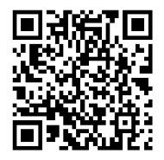
扫描二维码，下载申请表，填好个人信息
发送到TJFSUkggxhy@163.com邮箱
Scan the QR code, download the application form,
fill in the personal information, and send to TJFSUkggxhy@163.com
申请截止时间：1月31日
Deadline for application: January 31

